Slide 1
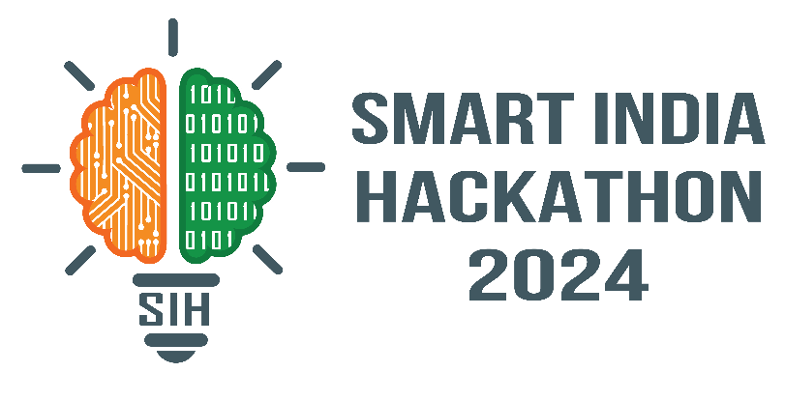
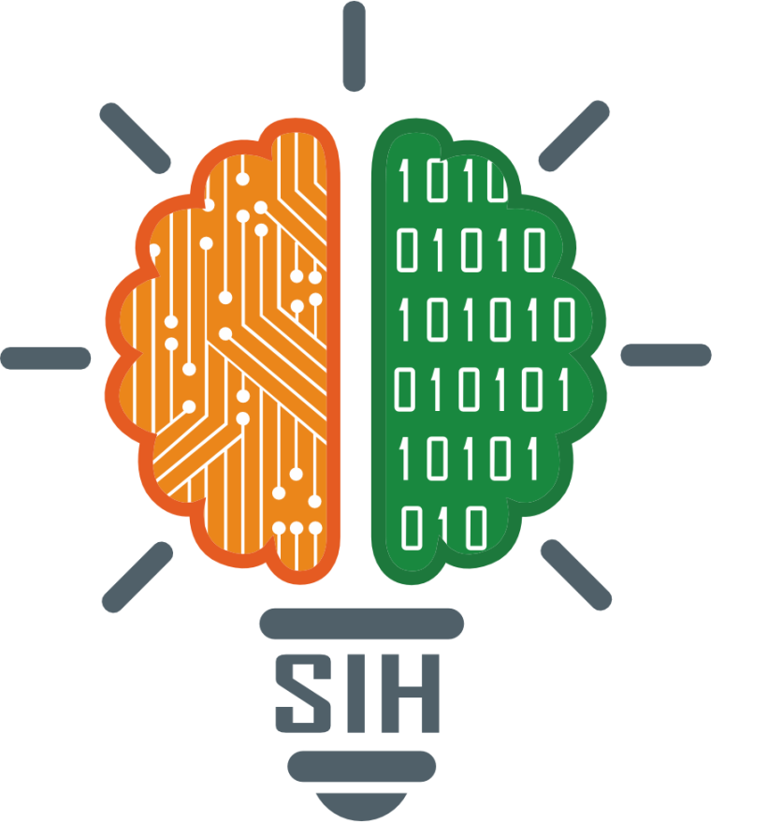
SMART INDIA HACKATHON 2024
TITLE PAGE
Problem Statement ID – 1545
Problem Statement Title- Development of a non-electrical device for tracking the movement of the sun for movement of the solar panels, increasing their efficiency
Theme- Renewable / Sustainable Energy
PS Category- Hardware
Team ID-SIH_2024_011
Team Name (Registered on portal) - THE SUN ARC

Slide 2

A self-calibrating Sun Tracker
based on a Differential Pressure Control System
Solar Tracker
Uses a Differential Pressure Control System
Initialize the system
Power up the system
Set panel position
Verify pressure system
Run diagnostics
Detect Sunlight & Evaluate sunlight
NO
YES
Determine if sunlight is detected
Return panel to initial position
Adjust Panel Position
Using differential pressure control to reorient panel
using gear and spring system
by movement of volatile liquid within the canister connected by a conduit, one position at each end of the pivotable frame
Return to Detect sunlight

Slide 3
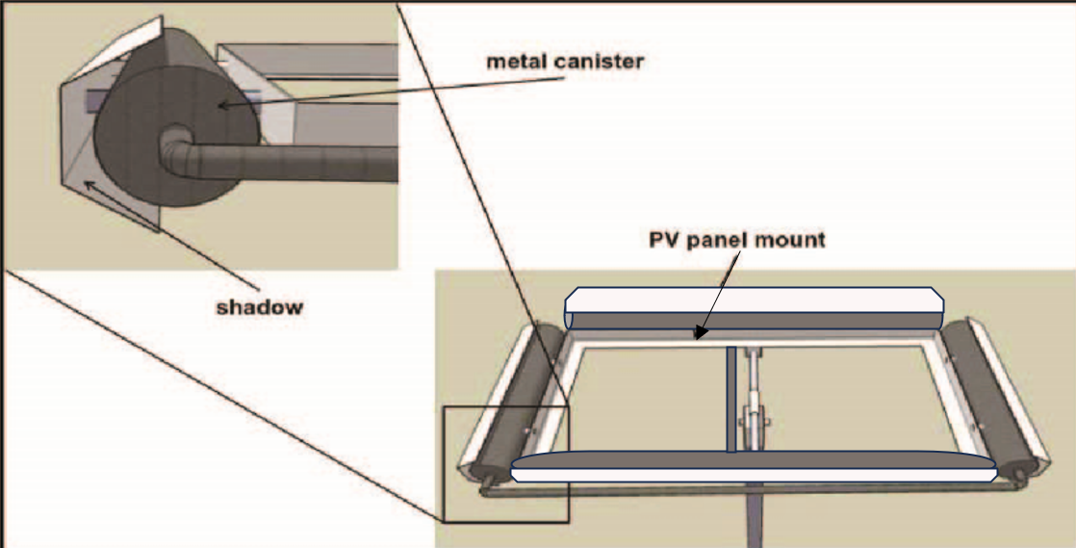
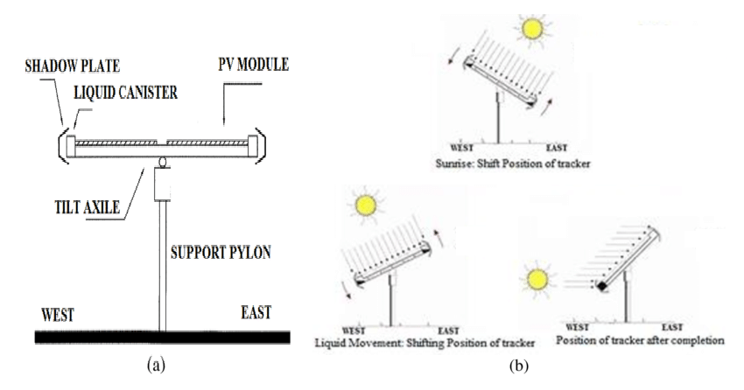
TECHNICAL APPROACH
Your Team Name
The system consists of canisters at each end which are interconnected at the lower ends with copper tubes.
A shadow bar covers the outer half of each canister to shade the nearby canister from direct sunlight when the sun is not directly above the collector surface.
A volatile liquid and its vapor are filled in the canisters. As the sun moves from east to west, the east canister is heated more compared to the west canister, forcing the volatile liquid into the west canister.
This continuously transfers volatile liquid from the east canister to the west canister which creates weight imbalance and to maintain equilibrium at approximately 15°, per hour, while ensuring the frame follows and thus the frame is balanced when sunlight is equal and the solar panels remain pointed at the sun.
In the afternoon, as the frame follows the sun, it will reach its westward 55° stop. As the sun continues its movement, the vapor pressure of the volatile liquid in the east canister will continue to rise, forcing essentially all of the liquid into the west canister, as shown in the fig.
Once all the liquid has been moved to the west canister, the spring system will move the solar panel back to its initial position.

Slide 4
FEASIBILITY AND VIABILITY
Your Team Name
Feasibility | Viability | Challenges
Economic feasibility Has lower cost than electric tracking system No need for electric complex component reduces upfront and maintenance cost Ideal for areas with limited resources | Market Viability: Strong potential in areas with scarce or expensive electricity. Viable for rural, off-grid, and agricultural use. High demand in developing countries for cost-effective, low-maintenance solutions. | Environment challenges Performance can be affected by cloudy days, disrupting reorientation.
Technical feasibility Utilizes simple, reliable differential pressure control system – Easy to manufacture and maintain- ideal for remote and challenging environments | Long term viability Durable with minimal need for repairs Offers cost savings on energy and maintenance Simple and sustainable for long-term use | Fluid Management Proper movement of volatile liquid between canisters is crucial for functionality.
Strategies
Color-Coded Canisters | Use different colors or insulation to enhance differential heating and improve solar orientation.
Redesigned Tracking System | Dual-Cylinder Tracker: Develop a passive tracker with partially pressurized fluid, incorporating one-way dampers, springs, or eccentrically placed masses for quicker return and reduced complexity.
Gas Spring Utilization | Vapor Pressure Gas Springs: Use gas spring fluid with high vapor pressure to maintain correct orientation during low-light conditions.

Slide 5
IMPACT AND BENEFITS
Your Team Name
Increased Energy Production:
Non-electric solar trackers allow panels to follow the sun’s path throughout the day. By doing so, they maximize solar absorption.
This dual-axis tracker, which adjusts seasonal changes, can add up to 45% more electricity production¹².
Cost-Effectiveness:
The proposed Solar Tracking System strikes a balance between energy yield and installation/maintenance costs. While it is not as expensive as fully motorized electric trackers it still provide significant efficiency gain.
Reduced Reliance on Electrical Components:
Differential pressure control trackers don’t rely on any electric components.
This simplicity means fewer components to maintain and potentially replace over time.
Lower Maintenance Costs:
Since there are no electrical parts so maintenance becomes less intensive.
No motors to oil, no circuits to troubleshoot—just good ol’ sun-following ingenuity.
Sustainability and Accessibility:
By reducing reliance on electrical components, this tracker contribute to sustainable energy practices.
Plus, they make solar energy more accessible to a wider range of users, including those who might not have easy access to electricity.

Slide 6
RESEARCH AND REFERENCES
Your Team Name
W. Lin, G. Deng, T. Wang, L. Sun, and L. Du, “A self-calibrating sun tracker based on a differential pressure control system,” in Materials for Renewable Energy and Environment (ICMREE), 2013 International Conference on, vol. 2. IEEE, 2014, pp. 450–453.
zomework, http://www.zomeworks.com/
A. P. N. J. Parmar, A. N. Parmar, and V. S. Gautam, “Passive solar tracking system.”
Features of solar tracker:
https://www.tatapowersolar.com/wp-content/uploads/2018/01/02052435/Feature-Solar-Tracker.pdf
https://www.greentechrenewables.com/question/what-passive-solar-tracking
https://www.adamheisserer.com/passive-solar-tracking

